Slide 1
Building Single page applications

Slide 2
What’s the deal with internet thing?
Dude, have you seen this internet thing?
Browsers are getting cooler and more powerful
User expectations are going up

Slide 3
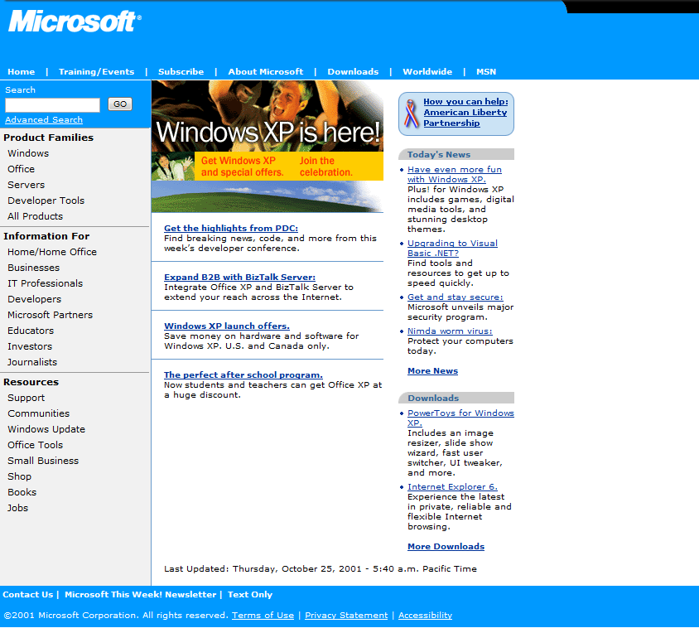

Slide 4
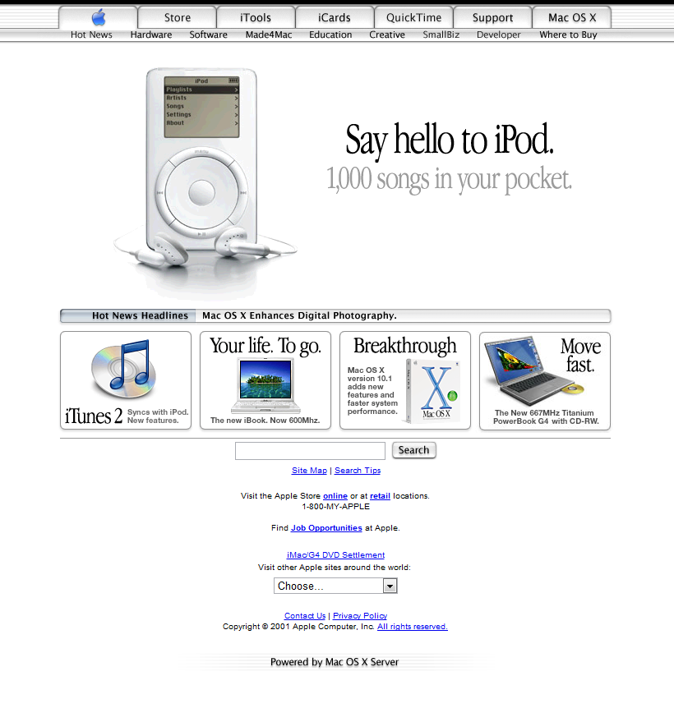

Slide 5
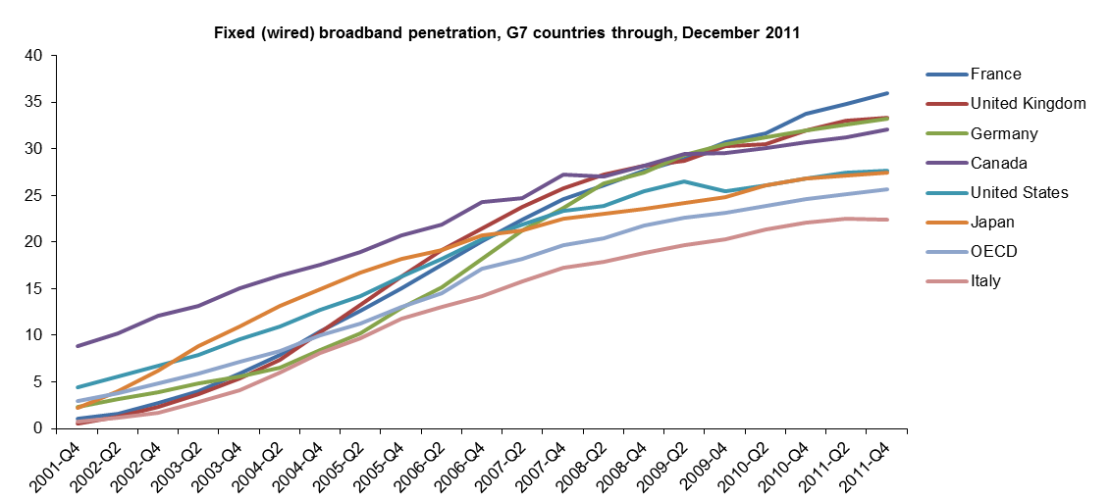
Broadband is way up

Slide 6
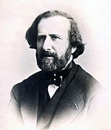
But browsing the net can still be slow
One of the first estimates of the speed of light
315 000 km/s
~5% of modern value
Hippolyte Fizeau
(1819-1896)

Slide 7
Shifting functionality to the browser
AJAX
Fast JavaScript
Great JavaScript libraries
Browser Data Storage

Slide 8
How can asp.net mvc help with ajax?
Controllers can take and return JSON
WebAPI allows for RESTful services
JavaScript minification and concatenation

